Slide 1


Department of Computer Science University of Bristol
COMSM0086– Object-Oriented Programming with Java
Abstract Classes, Interfaces, DoD, Static Elements and Arrays!
Simon Lock | simon.lock@bristol.ac.uk
Sion Hannuna | sh1670@bris.ac.uk

Slide 2
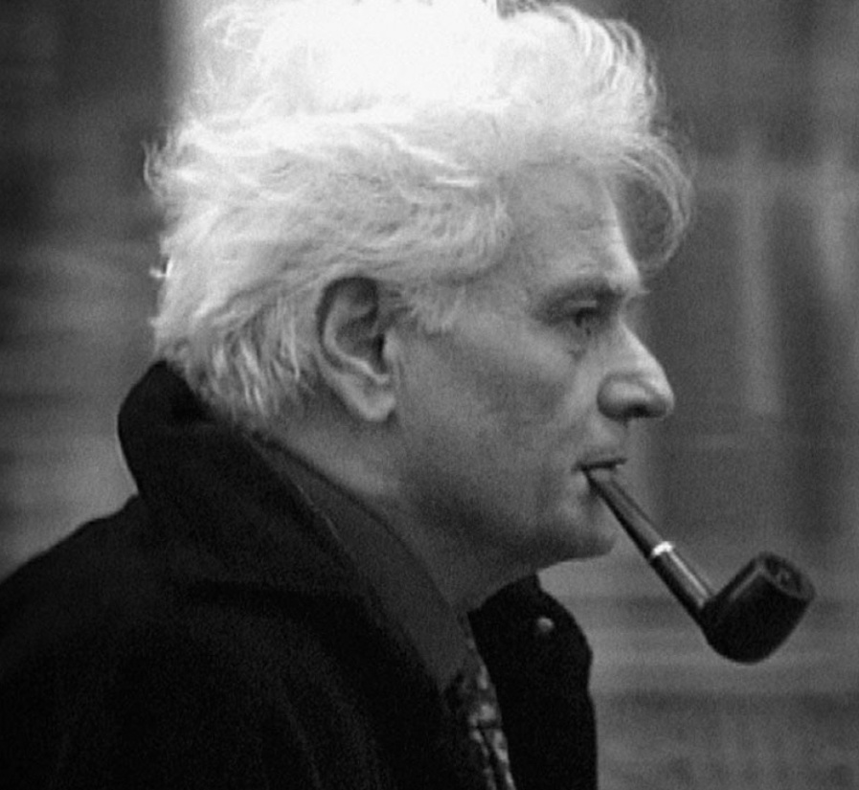
Recap: References

Slide 3

Classes and Reference Types
every object belongs to a class
classes act like types; for instance, references to an object are given a particular type when we declare it:
→ What effects can we achieve by introducing sub-class relationships?
the reference to ‘type’ Robot
...
Robot c3po = new Robot("C3PO");
...
class Robot {
String name;
int numLegs;
float powerLevel;
Robot(String productName) {
name = productName;
numLegs = 2;
powerLevel = 2.0f;
}
void talk(String phrase) {
if (powerLevel >= 1.0f) {
System.out.println(name + " says " + phrase);
powerLevel -= 1.0f;
} else {
System.out.println(name +
“ is too weak to talk.");
}
}
void charge(float amount) {
System.out.println(name + " charges.");
powerLevel += amount;
}
}
here we specify the type of object the reference c3po can point to
the constructor called must then relate to the type we specified

Slide 4

RECAP: Sub-classes - inheritance

Slide 5

Fighting Code Duplication
Problem: you have written a class (e.g. Robot), which almost does what you want, but requires some extensions
Idea: extend features from the existing class by creating a child class that automatically receives all features of the parent class (e.g. name, talk(),…) without writing code again
Implementation: you define a new class (e.g. TranslationRobot) inheriting all features from the existing parent class, but add or adapt features so that the new class does exactly what you want
Result: leads to DRY (do-not-repeat-yourself) code where each feature has a single code source
class Robot {
String name;
int numLegs;
float powerLevel;
Robot(String productName) {
name = productName;
numLegs = 2;
powerLevel = 2.0f;
}
void talk(String phrase) {
if (powerLevel >= 1.0f) {
System.out.println(name+" says "+
phrase);
powerLevel -= 1.0f;
} else {
System.out.println(name +
“ is too weak to talk."); } }
void charge(float amount) {
System.out.println(name+" charges.");
powerLevel += amount;
} }
parent class Robot provides all its features to the child class
‘extends’ signals inheritance from Robot class
public class TranslationRobot extends Robot {
// class has everything that Robot has implicitly
String substitute; //and more features
TranslationRobot(String substitute) {
this.substitute = substitute;
}
void translate(String phrase) {
this.talk(phrase.replaceAll("a", substitute));
}
@Override
void charge(float amount) { //overriding
System.out.println(name + " charges double.");
powerLevel = powerLevel + 2 * amount;
} }
added method here
parent method is replaced here

Slide 6
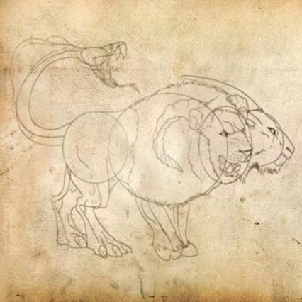
Polymorphism ( ... a first meeting with a powerful chimera ... )

Slide 7
Polymorphism (one reference, ‘many shapes’)
every reference belongs to a class (the one that the reference was defined as)
however, a reference can be made to any object of a sub-class of the reference’s class
this does not change the reference’s class
the principle that arises from the fact that one reference can refer to (potentially) various different classes is called polymorphism
in essence, it lets you use an object of a sub-class as if it was an object of some super class
simple case: reference class and object referenced are of the same type
...
Robot c3po = new Robot();
TranslationRobot c4po = new TranslationRobot("e");
...
Robot c5po = new TranslationRobot("e");
...
// BOGUS: TranslationRobot c6po = new Robot("e"); ...
legal and interesting case: object referenced is of a subclass of the reference class itself
illegal: the reference class cannot be a subclass of the object referenced, why?

Slide 8
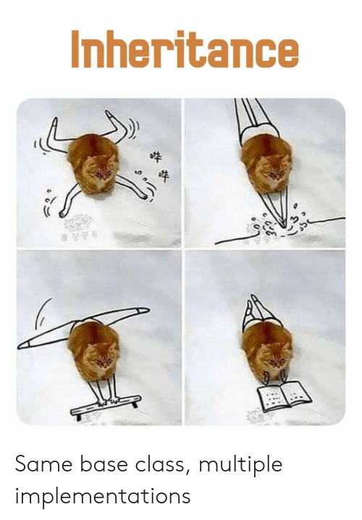

Slide 9
Mammal Magic
Let’s look at the classic mammals example …

Slide 10



Arrays in Focus: Creating, Initialising and Iterating
arrays (in Java) are objects too...
public class RobotArrays {
public static void main (String[] args) {
Robot[] robotsA = new Robot[3]; //instantiate array of references to 3 Robot objects System.out.println(robotsA[0]); //at start, array locations carry null
robotsA[0] = new Robot("C3PO"); //initialise entry at index 0 robotsA[1] = new Robot("C4PO"); //initialise entry at index 1
robotsA[2] = robotsA[0]; Robot[] robotsB = {
new Robot("C5PO"),
robotsA[0], robotsA[1]
};
//initialise with same reference as index 0
//neat initialisation syntax using {...}
System.out.println(robotsB.length); //print size of array robotsB
for (Robot robot : robotsB) System.out.println(robot.name);
//loop through entries, assign current to robot
//print name of current element
}
REMEMBER: This is an Iterator using the “:” notation, which provides a reference “robot” to each object held in the array turn-by-turn (The reference is not a one to the array location itself, which is not an object.)
...beware, it is the wrath of the null that you need to defend against in your programming...

Slide 11
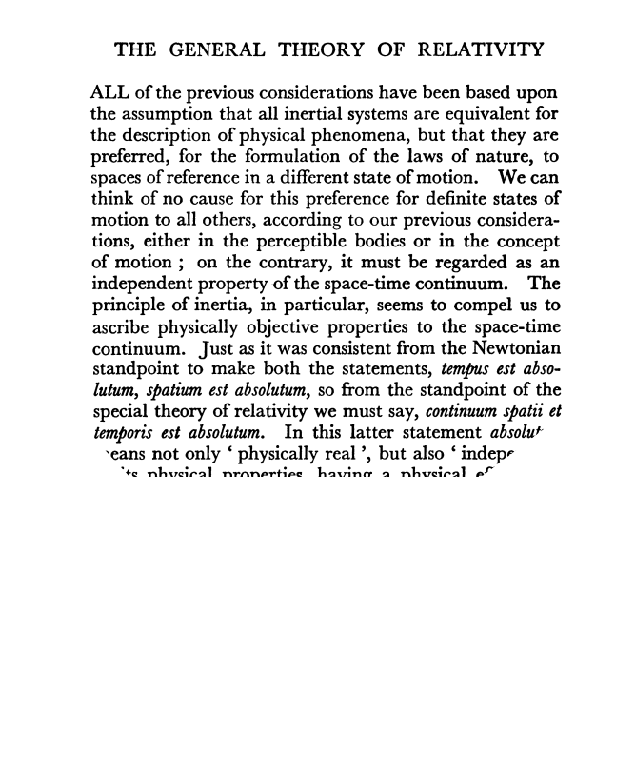
Abstract classes

Slide 12
Abstract Classes, Abstract Methods
to prevent us from making instances of a class we apply the abstract keyword to the class
abstract classes are often ones that are purely conceptual without any instances (e.g. a generic Shape, an AbstractRobot)
usually an abstract class contains abstract methods, that is methods which are declared, but supply no implementation (any non-abstract sub-class is forced to implement all these methods)
a class with one or more abstract methods must be declared abstract itself
no instance of AbstractRobot is ever allowed
abstract class AbstractRobot extends Robot {
abstract void greet(AbstractRobot other);
abstract void greet(TranslationRobot other);
abstract void greet(CarrierRobot other);
}
AbstractRobot.java
abstract methods provide no
implementation in the class, however, sub-classes may provide implementations

Slide 13
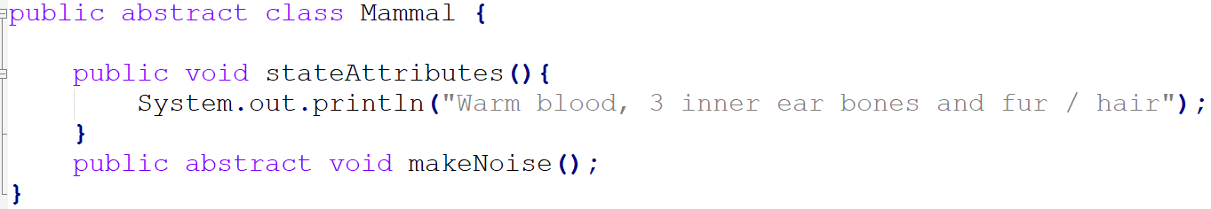
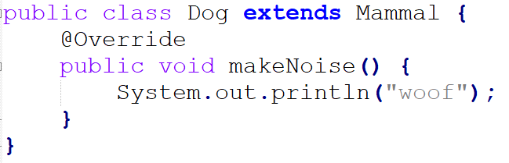
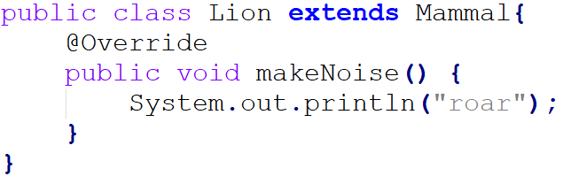
Fighting code duplication with inheritance
Define a parent class which defines attributes and methods common to the subclasses you plan to create:
Extend parent class with subclasses which add and / or override the parent class’s characteristics:
Notes:
Introduce idea of abstract methods and classes

Slide 14
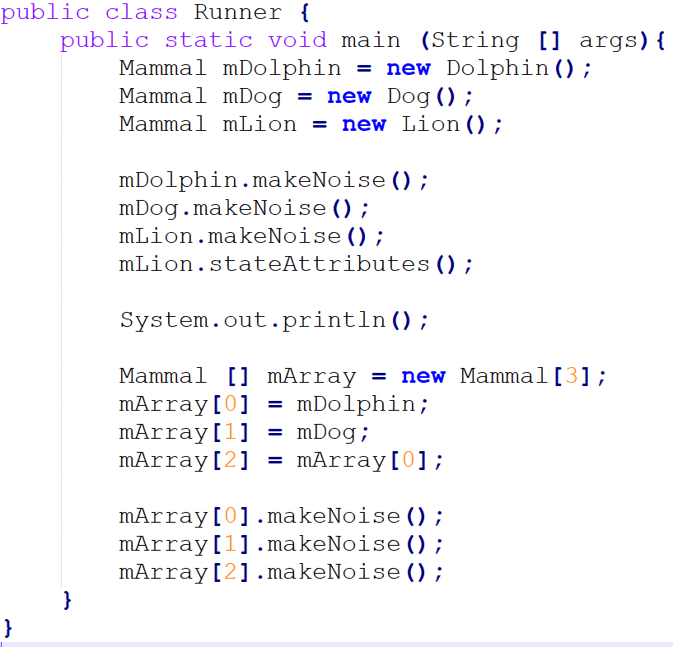
Polymorphism in action – single dynamic dispatch
when an overridden method is called via a reference, the actual method to execute is selected based on the type of the object referenced, not the reference type
this is known as `dynamic method dispatch’
since this dispatch decision cannot be made at compile time, dynamic dispatch refers to the choice of code execution (i.e. the method call) as resolved at runtime
call parameters, even if they are references, are treated as static …
Notes:
Mammal_stuff_basic

Slide 15

Interfaces

Slide 16
Interfaces
an interface is a reference type in Java, stored in a .java file and can be seen as a set of only abstract methods
thus, you cannot instantiate an interface and an interface does not contain any constructors
when a class implements an interface it inherits all the (implicitly abstract) methods of the interface
an interface may also contain constants, default and static methods, and nested types; implementations may exist only for static and default methods (more on this later)
an interface describes behaviours that a class implements
any class can implement multiple interfaces and an interface itself can extend multiple interfaces

Slide 17
Interface Example
Why do interfaces guarantee that there is no name clash?
Animal
<interface> Pet
void makeNoise()
void cuddle()
abstract class Animal {
abstract void makeNoise();
}
interface Pet {
void cuddle(); //implicitly abstract
void makeNoise();//implicitly abstract
}
a class can inherit from one parent class and implement multiple interfaces as well
Dog
it is ok to have a method name identical to the one of another interface or even class defined in an interface since there is no implementation provided
for a Dog class to be a concrete (i.e. non-abstract) class it has to implement all abstract methods from all interfaces it implements and classes it extends
class Dog extends Animal implements Pet {
@Override
public void cuddle() { // from Pet
System.out.println("Smelly cuddle!");
}
@Override
public void makeNoise() { // from Animal
System.out.println("Woof!");
} }
slide idea originally by N. Wu

Slide 18

Deadly Diamond of Death

Slide 19

Deadly Diamond of Death (DDD)
abstract class Animal {
abstract void makeNoise();
}
Animal
class Lion extends Animal {
void makeNoise() {
System.out.println("Roar!");
} }
void makeNoise()
Lion
Tiger
void makeNoise()
void makeNoise()
multiple inheritance is NOT allowed in Java
class Tiger extends Animal {
void makeNoise() {
System.out.println("Grrh!");
} }
Liger
class Liger extends Lion, Tiger {
void makeNoise() {
super.makeNoise(); // Liger would be ‘super’ confused
} }
slide idea originally by N. Wu

Slide 20
Associating Classes to Multiple Concepts
in multiple inheritance there is no simple way to resolve calls to super (one could use separate namespaces etc)
in response, Java forbids all multiple inheritance: a class can only inherit from one parent
`Liger’ may still be implemented via two has-a relationships
yet, we still would like a language construct that associates a single class with several parent concepts:
Animal
<interface> Pet
Lion
Tiger
Dog
Cat
Robot
slide idea originally by N. Wu

Slide 21


Static Elements (aka CLASS ELEMENTS)
( resist them )
Object-Oriented Programming | University of Bristol 20

Slide 22


Static Elements I
like for main, elements declared as static are associated to a class, not actual object instances
class RobotWorld {
RobotWorld.java
public static void main (String[] args) { Robot c3po = new Robot("C3PO"); c3po.talk("'Hello, Java!'");
}
}
static elements may be attributes, methods, blocks or nested classes
static elements are shared between all instances of that class, they can be accessed without instantiation
for an object oriented approach, avoid using statics unless you have a very good reason for it
Object-Oriented Programming

Slide 23
Static Elements II
static methods can access static data and can change the value of it
static methods cannot use non-static data members or call non-static methods directly
a static code block can be used to initialize the static data members (since constructors cannot do the job)
a static code block is executed before the main method at the time of classloading, at which time all static attributes are allocated their memory
Object-Oriented Programming

Slide 24

Staying in C-World
// DO NOT WRITE CODE // OF THIS STYLE, MOVE // OUT OF C-WORLD PLEASE
you can pretend you’re not in Java and have nothing to do with objects
to do that use the static keyword in front of your methods functions and attributes variables
if you do this, you demonstrate very nicely that you’ve completely missed the point of Java and object-orientation
do bad things like:
class CWorld { static int x; static int y;
static { x = 0; y = 10; }
static int fib(int n) {
switch (n) {
case 0: return 1;
case 1: return 1;
default:
return fib (n - 1) + fib (n - 2);
}
class UseCWorld {
}
public static void main (String[] args){
CWorld cw = null;
for (int i = 1; i < 10; i = i + 1 ) {
System.out.println( cw.fib(i) );
}
}
}
public static void main (String[] args) {
for (int i = x; i < y; i = i + 1 ) { System.out.println( fib(i) );
}
}
}
Object-Oriented Programming

